Slide 1
Customer Behaviour Analysis for Enhanced Marketing Strategies
Optimizing Marketing Efforts through Data-Driven Insights

Slide 2
Project Overview
Objective: To analyze customer behavior patterns to enhance marketing strategies and improve retention rates.
Data Summary: Overview of the data, highlighting customer interaction points, session information, transactions, and churn.
Methodology: Brief mention of data processing and analysis approach

Slide 3
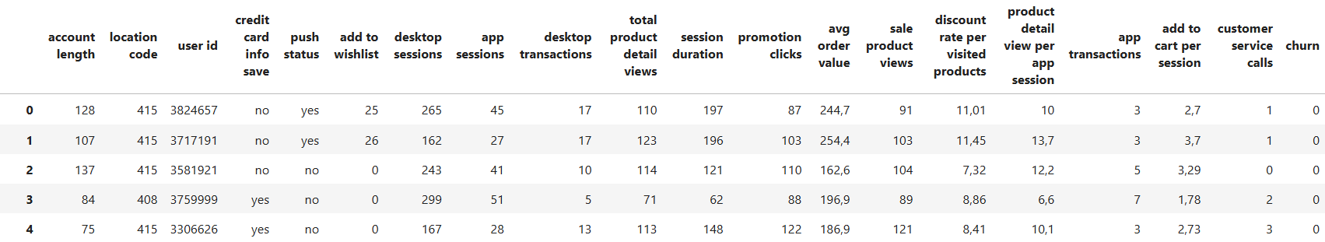
Data Overview
Dataset Structure: Briefly outline data columns like account length, desktop/app sessions, transactions, promotion clicks, churn.
Sample Size: “The dataset consists of 3,333 customer records with 20 features each.”

Slide 4
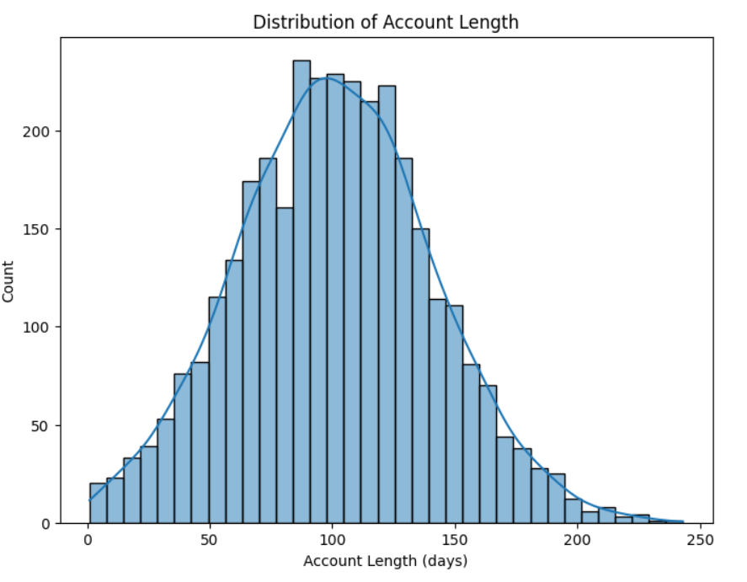
Distribution of Account Length
This plot shows the frequency distribution of customer account lengths, highlighting how long users typically stay with the service.
Plot Name: Distribution of Account Length
Insight: Most customers have account lengths centered around a moderate duration, with fewer very short or long tenures, suggesting a stable user base.

Slide 5
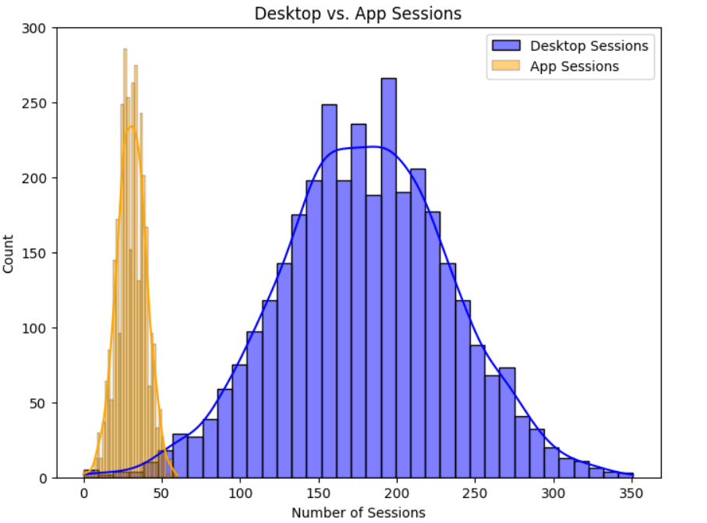
Analysis Insights - Customer Behavior
Desktop sessions are notably higher than app sessions, indicating desktop as a primary channel.
The difference suggests the potential for app-specific promotions to boost engagement.
Plot: Histogram/Density Plot of Desktop and App Sessions.
Insight: “Higher desktop session frequency indicates desktop as the primary channel, suggesting an opportunity to boost app engagement.”

Slide 6
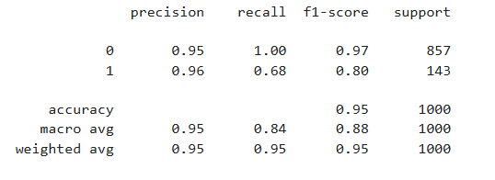
Model Accuracy and Performance
Churn Prediction Model: Random Forest Classifier
Model Accuracy Score: 95%
This score reflects the model's ability to accurately predict customer churn.
Detailed Metrics:
Precision:
Churn (1): 96% (percentage of customers predicted to churn who actually churned)
No Churn (0): 95% (percentage of customers predicted not to churn who actually did not churn)
Recall:
Churn (1): 68% (percentage of actual churners correctly predicted)
No Churn (0): 100% (percentage of actual non-churners correctly predicted)
F1-Score:
Churn (1): 80% (harmonic mean of precision and recall for the positive class)
No Churn (0): 97%
Support: Total Samples: 1,000 (857 non-churners and 143 churners)

Slide 7
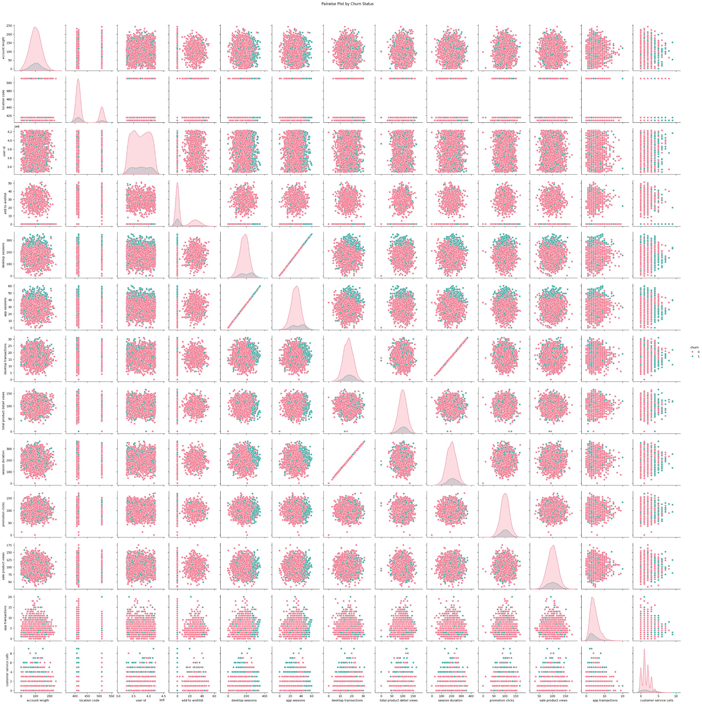
Churn Prediction Insights
Churn Prediction: High accuracy model with Random Forest classifier.
Primary Indicators of Churn: Session duration, customer service calls, promotion clicks.
Plot: Pairwise Plot by Churn Status showing relationships among key metrics like desktop/app sessions, promotion clicks, session duration.
Insight: "Higher desktop sessions and longer session durations correlate with lower churn, suggesting strong desktop engagement as a retention factor."

Slide 8
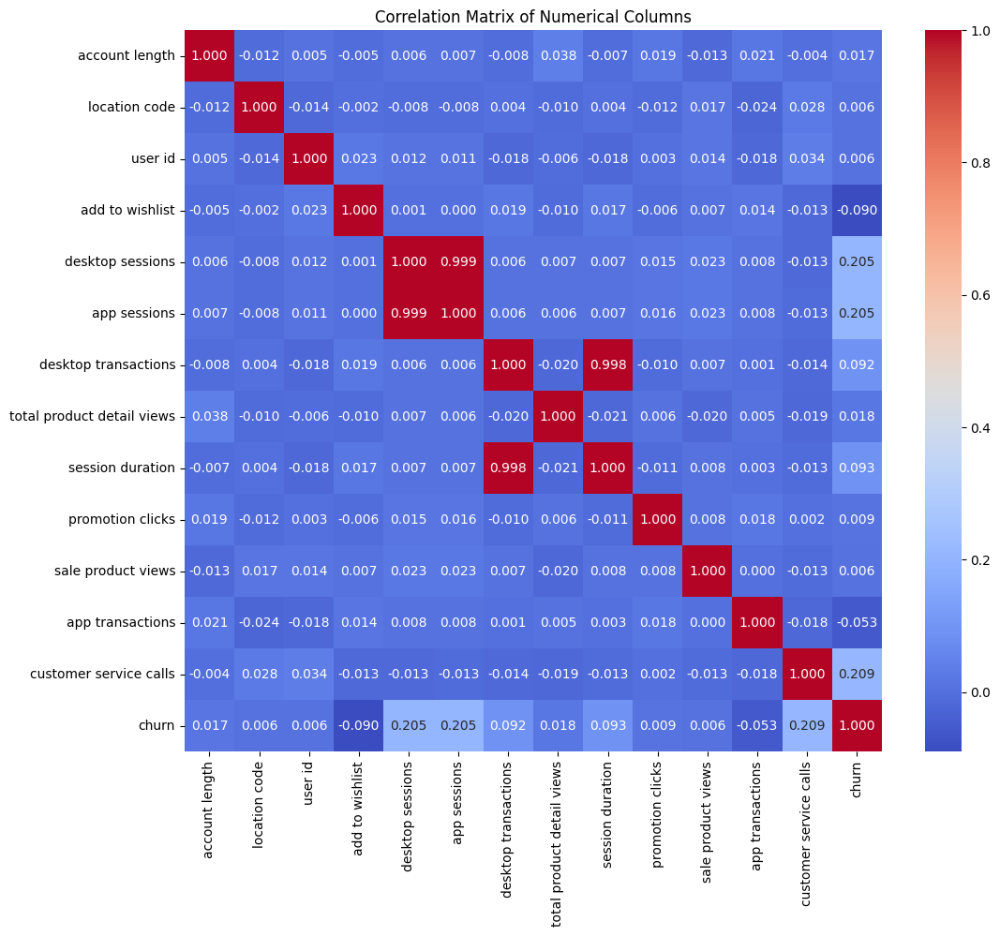
Correlation Analysis
High correlations found between promotion clicks and desktop transactions, indicating effective promotional engagement.
Plot: Correlation Heatmap showing correlations between sessions, transactions, promotion clicks, etc.
Insight: "Strong correlation between promotions and transactions suggests that targeted promotions drive engagement, especially on desktop."

Slide 9
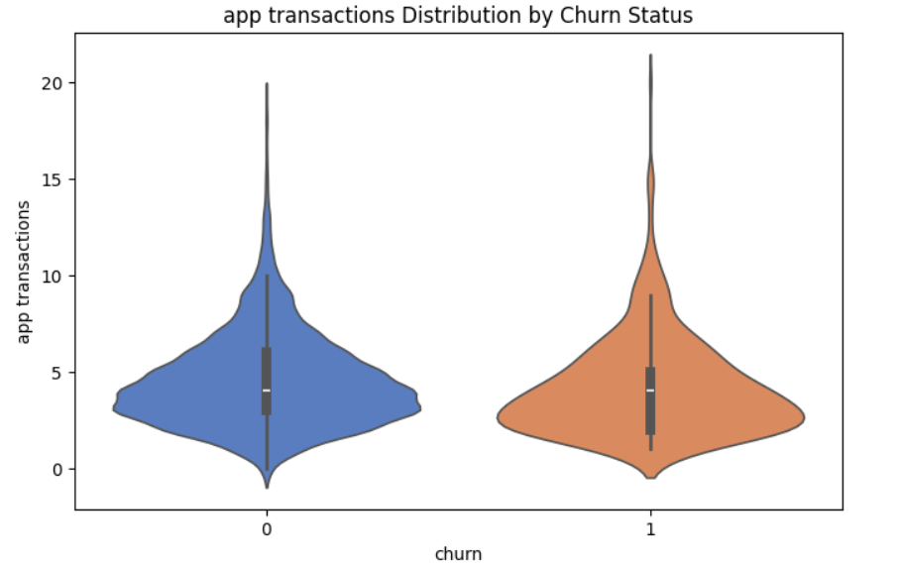
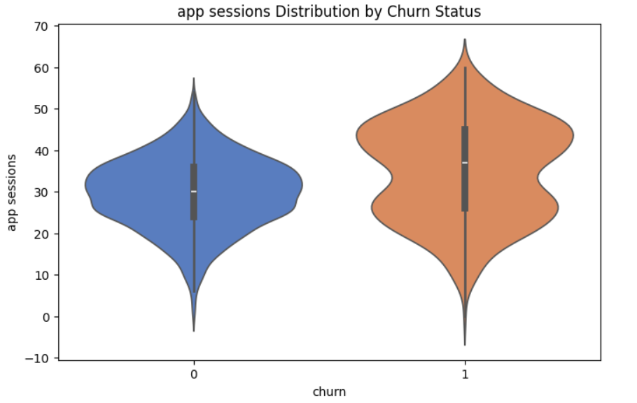
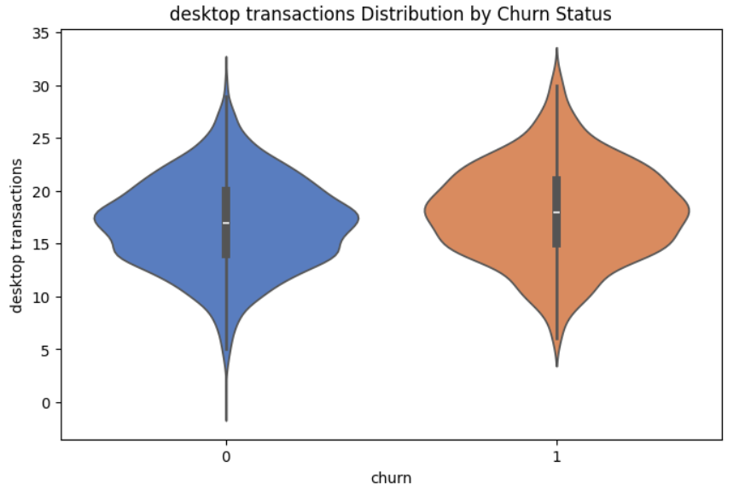
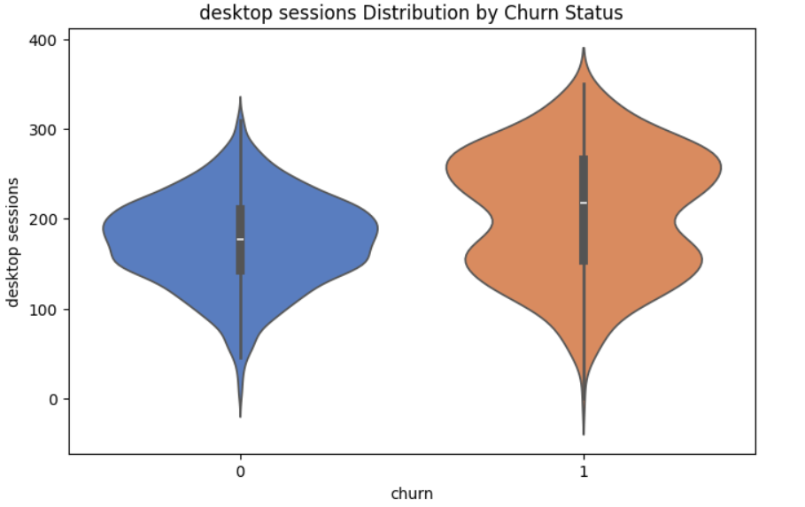
Recommendation #1 - Enhance Customer Segmentation
Segment customers based on desktop sessions, app usage, churn status, and customer service interactions.
Target high desktop users and those with frequent customer service calls.
Plot: Violin Plot of Desktop vs. App Sessions by Churn Status.
Insight: “Segmenting based on usage and service interaction can identify retention opportunities.”

Slide 10
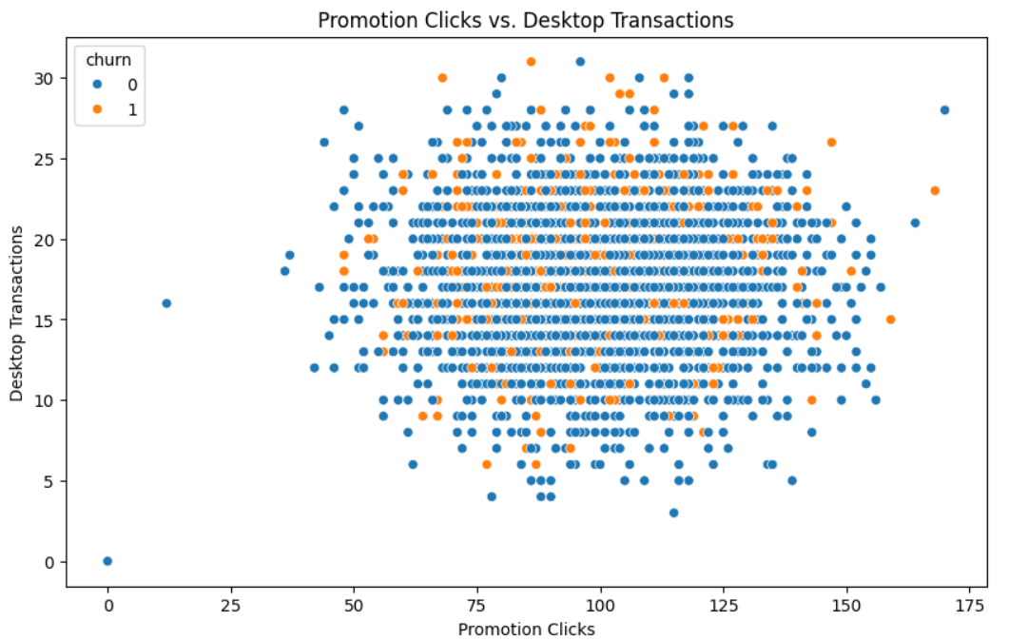
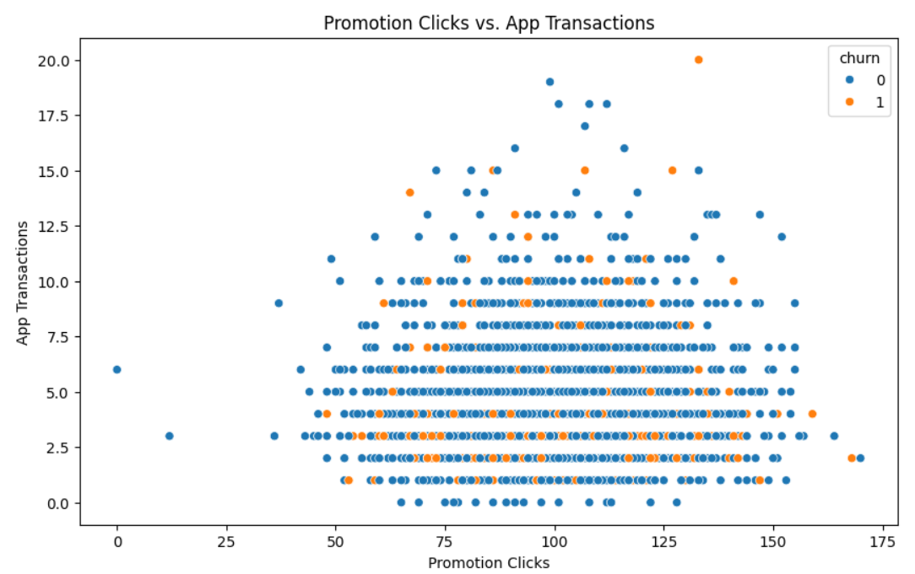
Recommendation #2 - Optimize Promotions and Discount Strategy
Leverage insights from promotion clicks to increase transaction counts.
Optimize discount rates per product based on user responsiveness.
Plot: Scatter Plot of Promotion Clicks vs. Transactions (Desktop vs. App).
Insight: “Desktop users show stronger responses to promotions, so desktop-focused discounts can increase transaction volume.”

Slide 11
Final Recommendations & Next Steps
Key Recommendations:
Enhance Segmentation: Use detailed segmentation based on engagement metrics such as session frequency and customer interactions to personalize marketing efforts.
Tailor Promotions: Develop targeted promotions by channel (e.g., app-specific offers) to increase engagement and retention.
Implement Churn Prediction: Utilize the Random Forest model for ongoing churn prediction, enabling proactive outreach to at-risk customers.
Test and Optimize: Regularly conduct A/B testing on promotional strategies to assess effectiveness and optimize campaigns based on data-driven insights.
Feedback Loop: Establish a feedback mechanism from customers to continually refine customer profiles and improve promotional strategies based on their responses.
Next Steps:
Conduct periodic reviews of customer data to adjust segmentation strategies as behavior changes over time.
Monitor key performance indicators (KPIs) post-implementation to measure the impact of recommendations and make necessary adjustments.
Schedule regular training sessions for the marketing team on data analytics tools and techniques to enhance their ability to leverage insights effectively.

